Slide 1




Enough is Enough: Learning to Stop in Generative Systems
Colin Roitt, Simon Hickinbotham, Andy M. Tyrrell
University Of York, School of Physics, Engineering and Technology
Paper 56

Slide 2


Evolution vs Design
Evolution offers many interesting characteristic which would be beneficial to Engineering design
  Complexity
  Novelty
  Reliability
How do we control this into design?
  Mapping from genotype to phenotype
  Control the direction of evolution to design constraints
  Keeping methodology a reasonable option in design process – efficiency, reliability
R. Dawkins, ‘The evolution of evolvability’.
K. Sims, ‘Evolving 3D morphology and behavior by competition’.

Slide 3

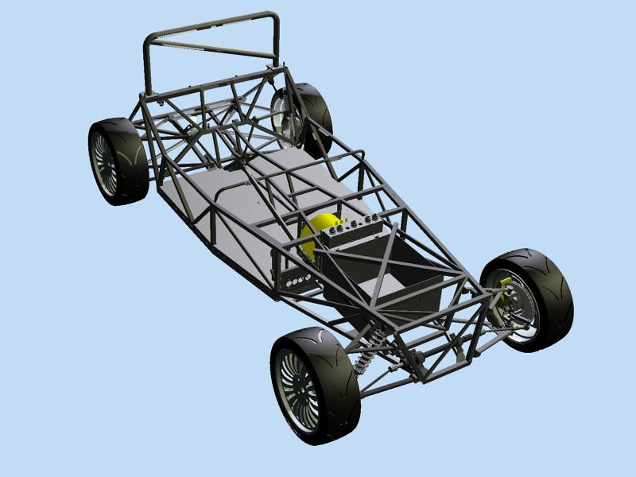

Evolve this car chassis
What does a genome look like?
How does a genotype map to this phenotype?
Could be defined explicitly
  Task specific
  Complex and large genome
+

Slide 4
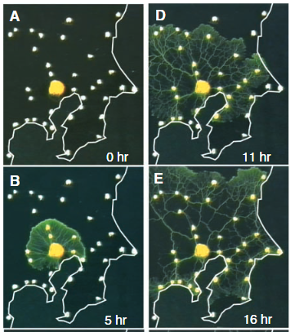
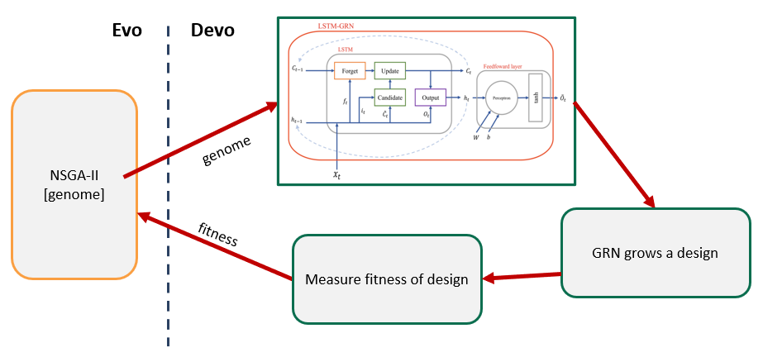
Biologically inspired approach
Nature is extremely good at finding solutions to complex problems in complex environments
Artificial Evolutionary Development – Evo Devo
Evolution offers optimisation algorithm - Development offers evolvable encoding
Indirect genotype-phenotype encoding
A. Tero et al., ‘Rules for biologically inspired adaptive network design’.
Evolve a GRN where the fitness is a function of how well it controls growth
Development (growth) controlled by gene expression of a gene regulatory network (GRN)
GRNs can be encoded and evolved easily
Simple Genotype maps to complex Phenotype

Slide 5
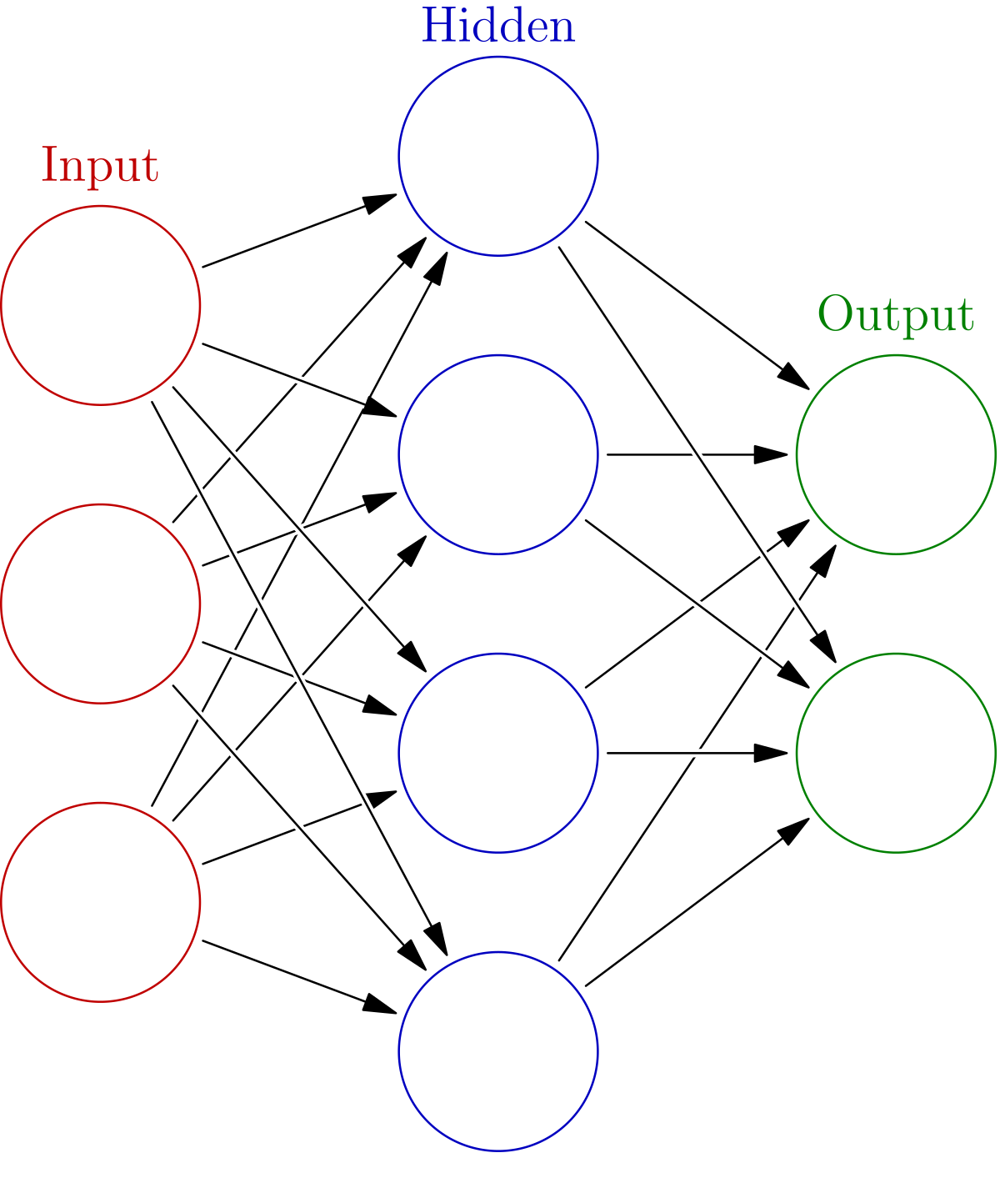
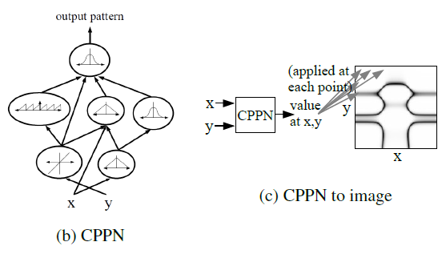
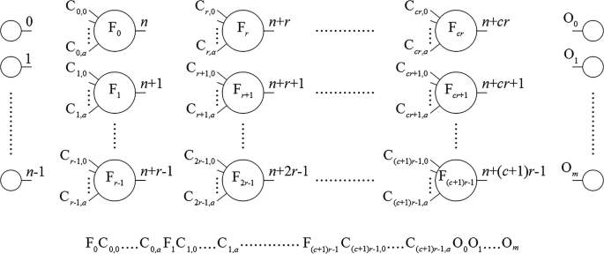
Swapping out Gene Regulatory Networks
There is no off-the-shelf GRN model.
A GRN should:
  Control for development over time (heterochrony)
  Control gene expression spatially
  Allow genes and products of genes to interact
Inspired by the ability of Neural Network-like structures
W. Banzhaf, ‘On the Dynamics of an Artificial Regulatory Network’.

Slide 6

Stopping problem
Artificial evolution has stopping criteria – but what about development
Could be determined by pre-controlled limits
  Issue: Forcing evolved solution to fit potential bias
  Too many steps is a waste of resources
  Too few may over-constrain solution
Stopping (and heterochrony) is an evolved characteristic in Nature
Potential solution in offloading stopping decision to GRN

Slide 7
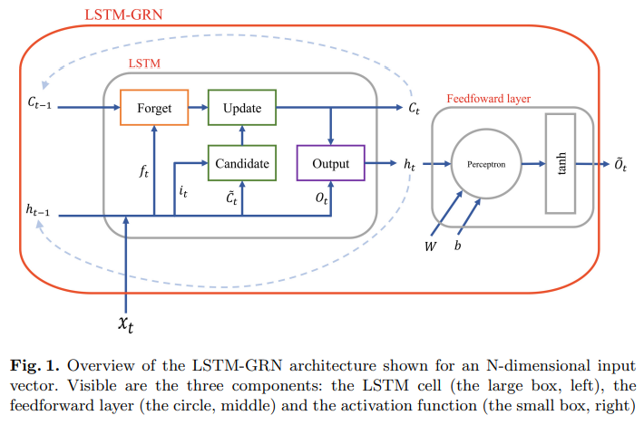
Thinking with Recursion
Augment a GRN with an LSTM unit
1 Long-Short term Memory network + NN/perceptron
Stopping requires context of environment and historical actions
  But still early days in evolving LSTMs
List genome of weights and biases at each connection point

Slide 8
The flow of memory – over one step
Add to long term from short term
Long term memory loop – from previous step
Use updated long and short memories to generate output
Short term informs loss of long term
Used as output
Combine short term and input values
Short term memory loop - from previous step
Input of step

Slide 9
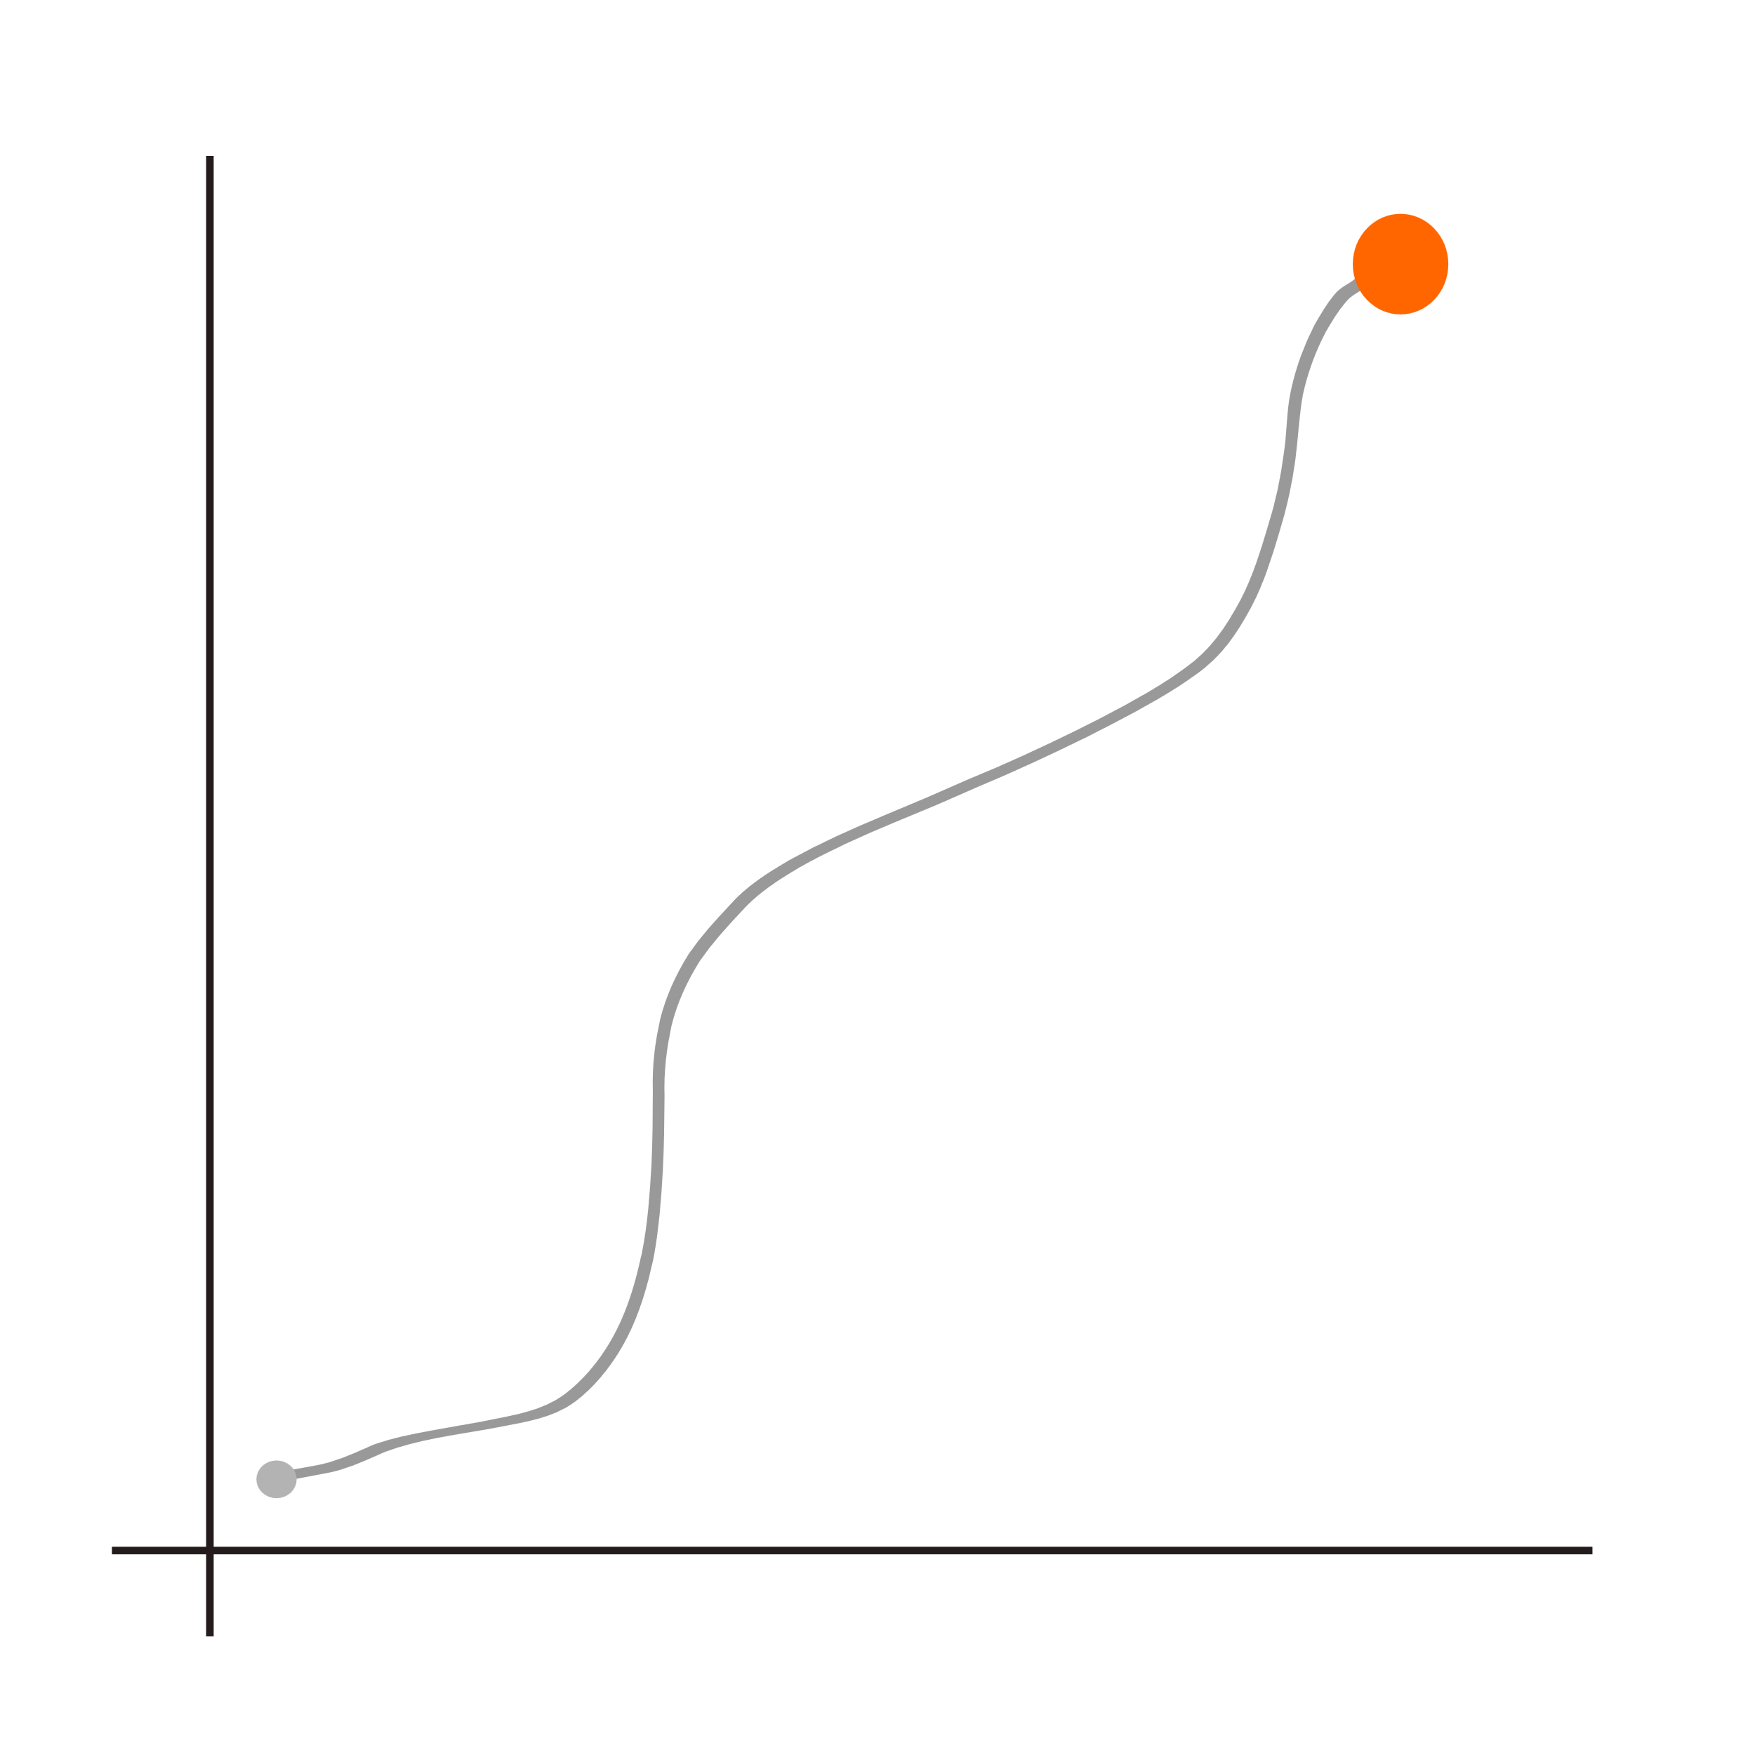
Problem 1: Setup
Organism begins near origin
Must take growth/development steps moving towards target
Fitness is [number of steps, distance from target]
Both minimised with NSGA-II
Network Inputs: [X_pos, Y_pos, halt]
Network outputs: tanh - [step_size, angle, halt]
If halt is < 0 devo stops
Notes:
Simple for understanding – then more complex later
Halt is looped back in from prev step
GRN doesn’t know where target is

Slide 10
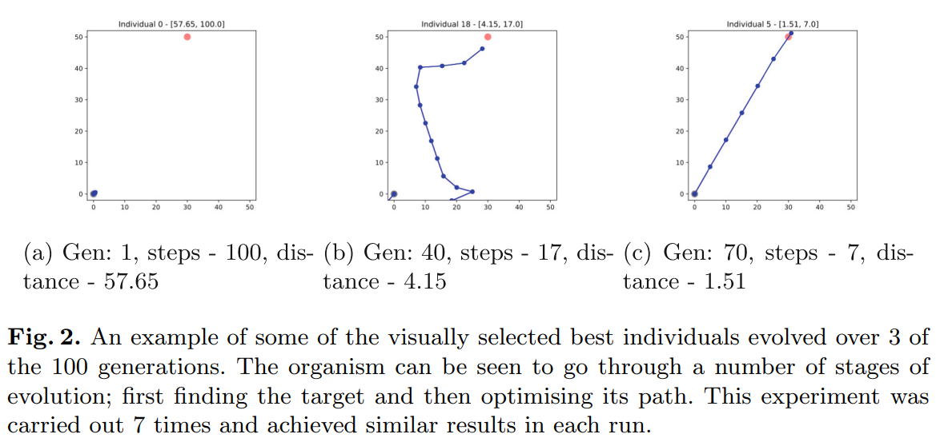
Emergent properties - stopping
On a simple problem

Slide 11
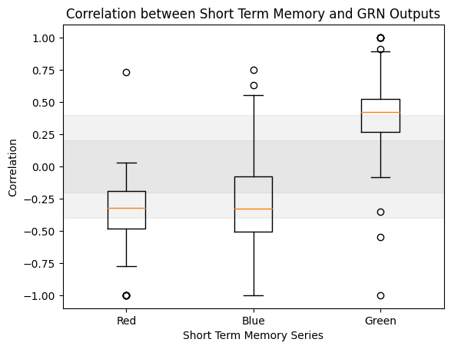
Investigation into Memory
Impact of memory on output
3x1 vector short-term memory values (labeled red, blue, green)
Plot correlation of each value with STOP output value
HOWEVER: Clamping memory values did not change the output of the GRN
  This correlation is NOT causation

Slide 12
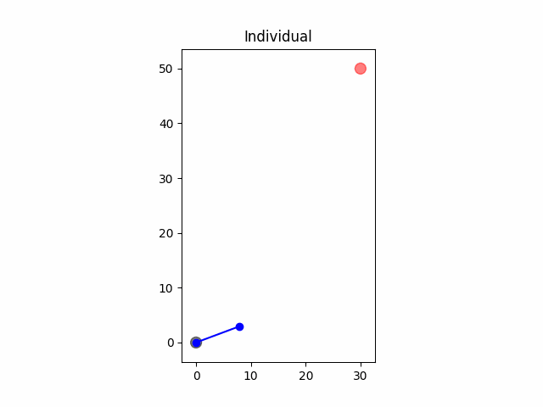
Clamping input values of a typical individual
Clamping X value to its normal final value (29)
Uses all devo steps – doesn’t stop
Clamping Y value to its normal final value (50)
Stops step 1
Other non-memory weights are responsible for stopping, it’s learning a fixed value and not using historical values.

Slide 13
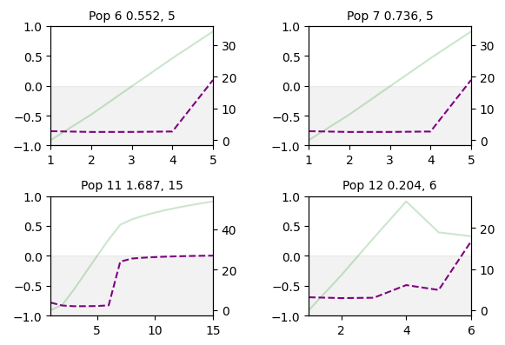
Known stopping condition
GRN looks for height at 50 (for example) then triggers stopping value
Green – y value
Purple – stop signal
Too simple a problem to investigate in this depth
Takeaway – network too simple, “interaction with genes and their products”

Slide 14
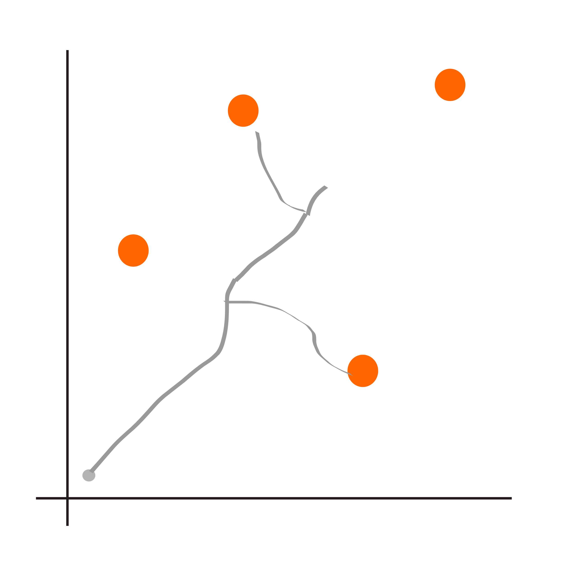
Problem 2: Setup
LSTM-GRN does find a solution to simple problem so more complex on approached
Extend problem 1 to allow branching growth
Add two commands
  Network outputs: tanh - [step_size, angle, halt, push, pop]
Push and Pop can read or write the current position to a stack
POS 4 POS 2 …
Notes:
Unsure how best to display this stack idea – will iterate this once or twice more

Slide 15
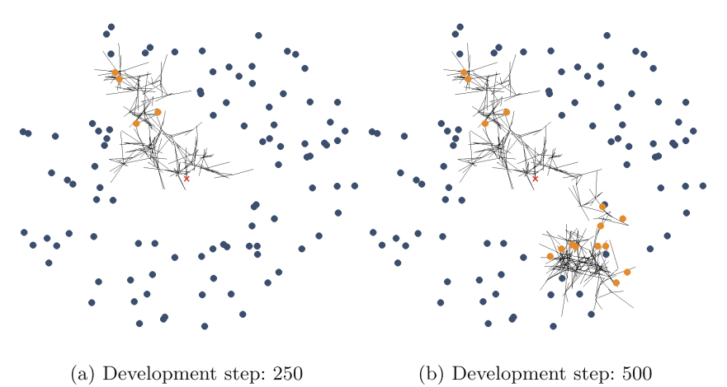
Complex systems cannot keep up…
2D branching manages to avoid empty space
Unable to determine stopping criteria – uses max number of devo steps available
System can operate appropriately up to a certain point of complexity

Slide 16
Key takeaways
An LSTM based GRN is able to evolve itself to solve simple tasks
The evolutionary space of ‘memory’ is quite large – evolution can produce some unexpected results
This simple model struggled with complex tasks
There is a difference between optimising to a task and learning to stop
Set the ground-work for more exploration of recurrency in GRNs
Topological evolution of the system may allow greater room for complexity
Other metrics to decouple evolving to stop and learning to stop

Slide 17
Enough is Enough: Learning to Stop in Generative Systems
Colin Roitt, Simon Hickinbotham, Andy M. Tyrrell
University Of York, School of Physics, Engineering and Technology
Paper 56
Notes:
R. Dawkins, ‘The evolution of evolvability’, On growth, form and computers, pp. 239–255, 2003.
K. Sims, ‘Evolving 3D morphology and behavior by competition’, Artif. Life, vol. 1, no. 4, pp. 353–372, Jul. 1994.
A. Tero et al., ‘Rules for biologically inspired adaptive network design’, Science, vol. 327, no. 5964, pp. 439–442, Jan. 2010.
W. Banzhaf, ‘On the Dynamics of an Artificial Regulatory Network’, in Advances in Artificial Life, 2003, pp. 217–227.

